Slide 1


Mobile Application
Ontology
Luca Tomei 1759275

Slide 2
Outline of Talk
Context and Purpose
1
Why Mobile Applications and what is the purpose?
Classes & Properties
2
How to model the ontology?
Representation
3
Entity-relationship diagram and graphical description.
Querying Ontology
4
Data extrapolation.

Slide 3
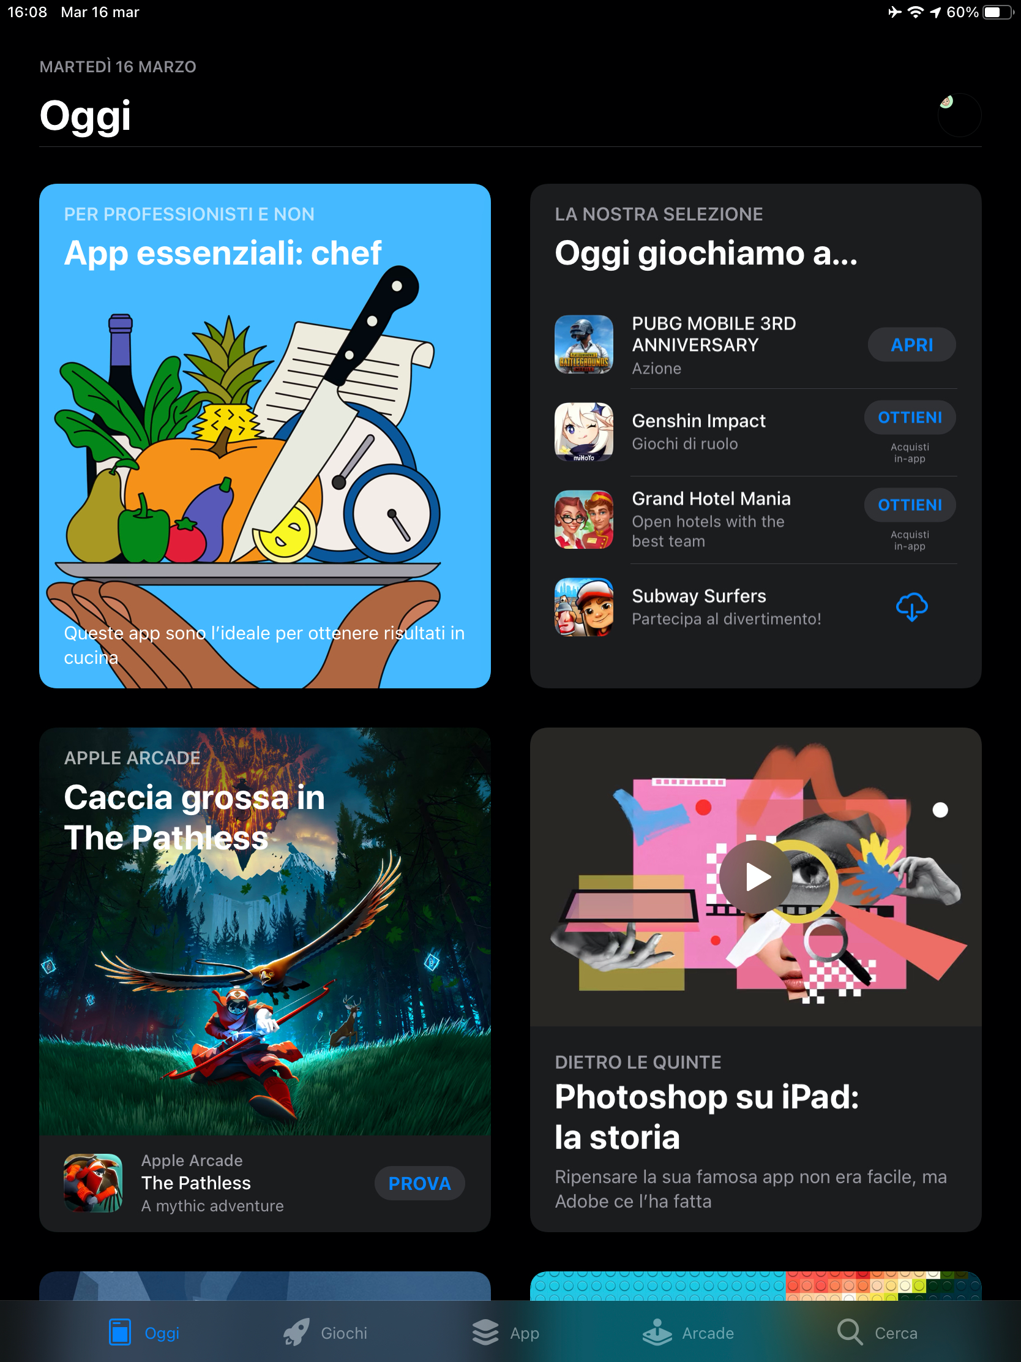
Context
and Purpose
1
Mobile applications are a striking example of developing a complex ontology and capturing the links between their modeling.
The purpose of the ontology is to provide an overview of the modeling and classification of mobile applications, along with some concrete examples.

Slide 4
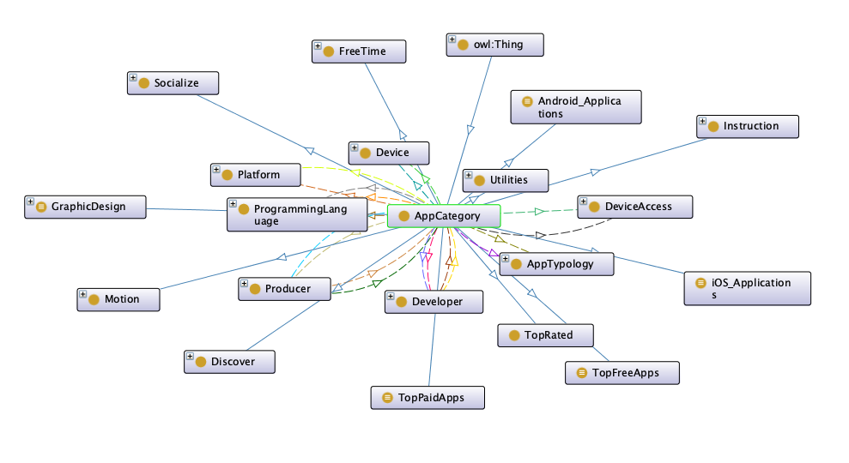
2.1
Classes and Properties
Application Category
To create ontology, 49 classes have been used, designating the most important areas of interest for users of mobile applications, representing their interests.
The AppCategory class represents the largest and most well represented ontology class: Among the subclasses we mention: Lifestyle, Fitness, Games, Education, Social Networking, etc.
Each concrete example of the application is represented as an instance of a subclass of Category.

Slide 5
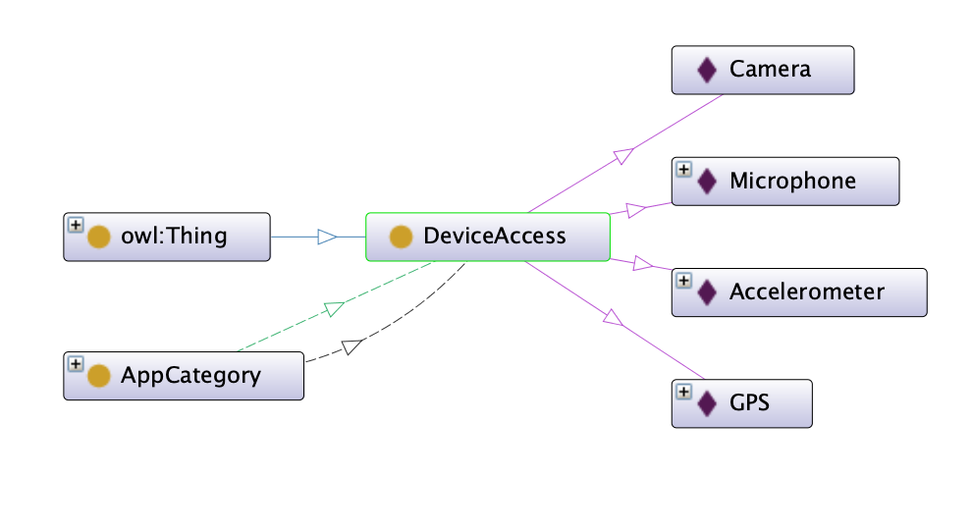
2.2
Classes and Properties
Device Access
DeviceAccess class has the role of representing the structures of the telephone to which the application can request access, in the form of a request for rights..
As subclasses we specify: Accelerometer, Camera, GPS, Microphone.

Slide 6
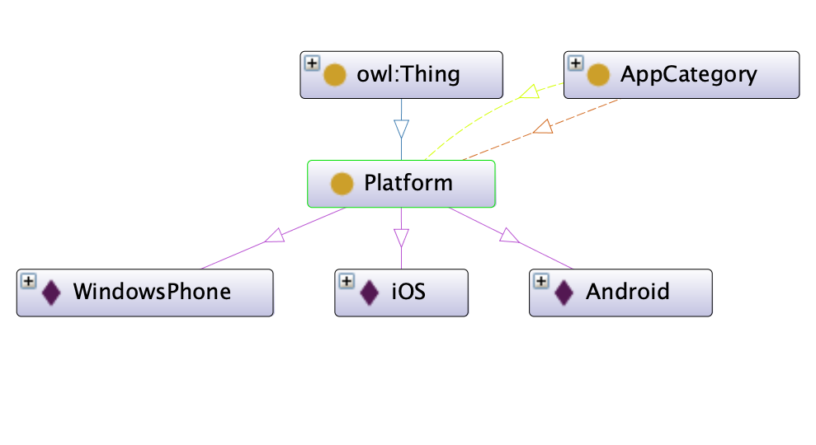
2.3
Classes and Properties
Platform
Platform class represent mobile platforms for which applications can be deployed, such as Apple's iOS platform, Google's Android and Microsoft's Windows Phone.

Slide 7
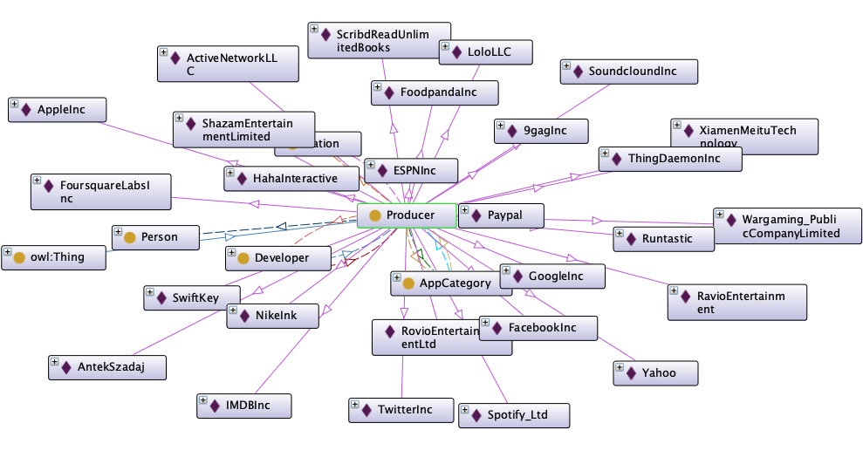
2.4
Classes and Properties
Producer
AppTypology class refers to the three important types in the classification of mobile applications: Native, Wer, Hybrid.
Native applications are those applications developed only for mobile phones, Web applications are those that can be accessed as a URL, and hybrid applications are applications with support on both sides.

Slide 8
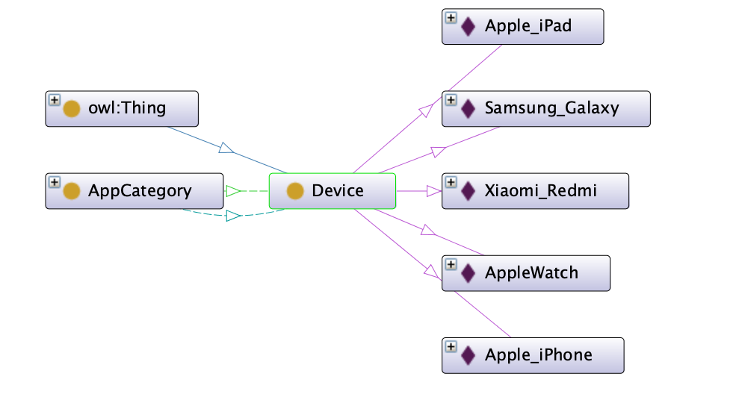
2.5
Classes and Properties
Device
Device class refers to the three important types in the classification of mobile applications: Native, Wer, Hybrid.
Native applications are those applications developed only for mobile phones, Web applications are those that can be accessed as a URL, and hybrid applications are applications with support on both sides.

Slide 9
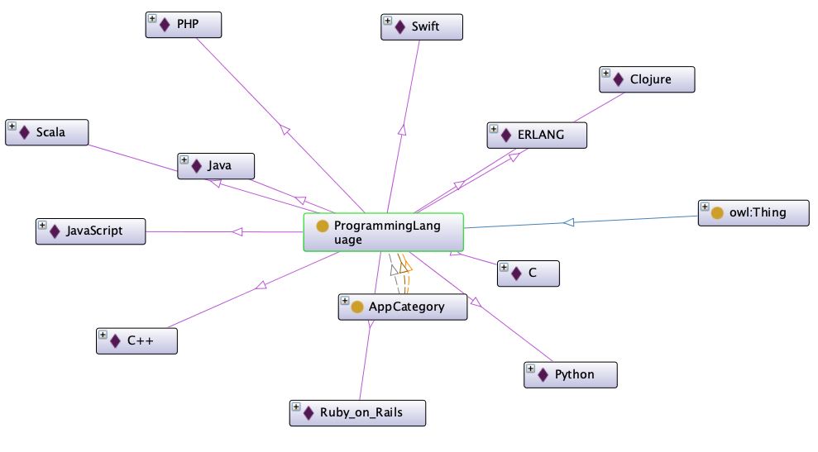
2.6
Classes and Properties
Programming Language
The type of Programming Language used is specified for each application.
Usually in software development we divide a programming language into Front-end and Back-end.

Slide 10
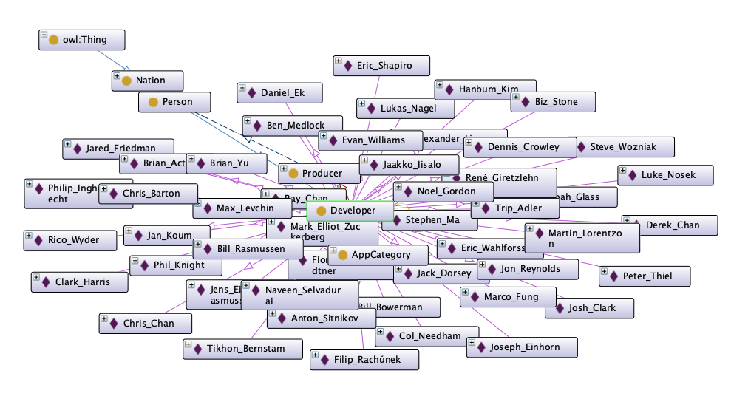
2.7
Classes and Properties
Developer
The Developer class is a subclass of Person
We need to connect applications with their Developers

Slide 11
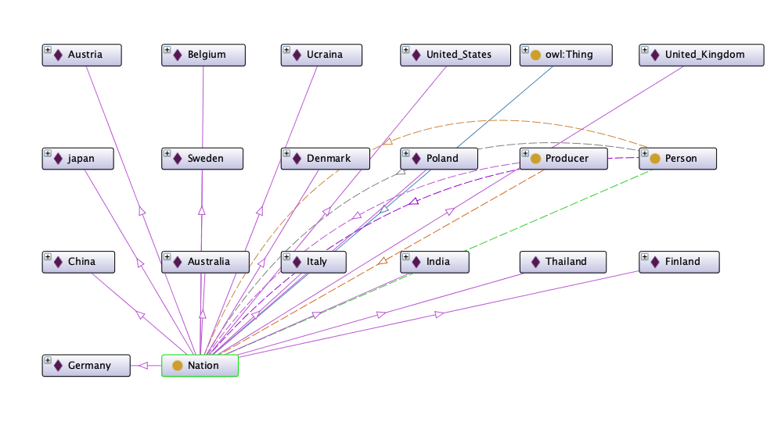
2.8
Classes and Properties
Nation
The Nation class is intended to connect Producers' headquarters and People's birthplaces and places.

Slide 12
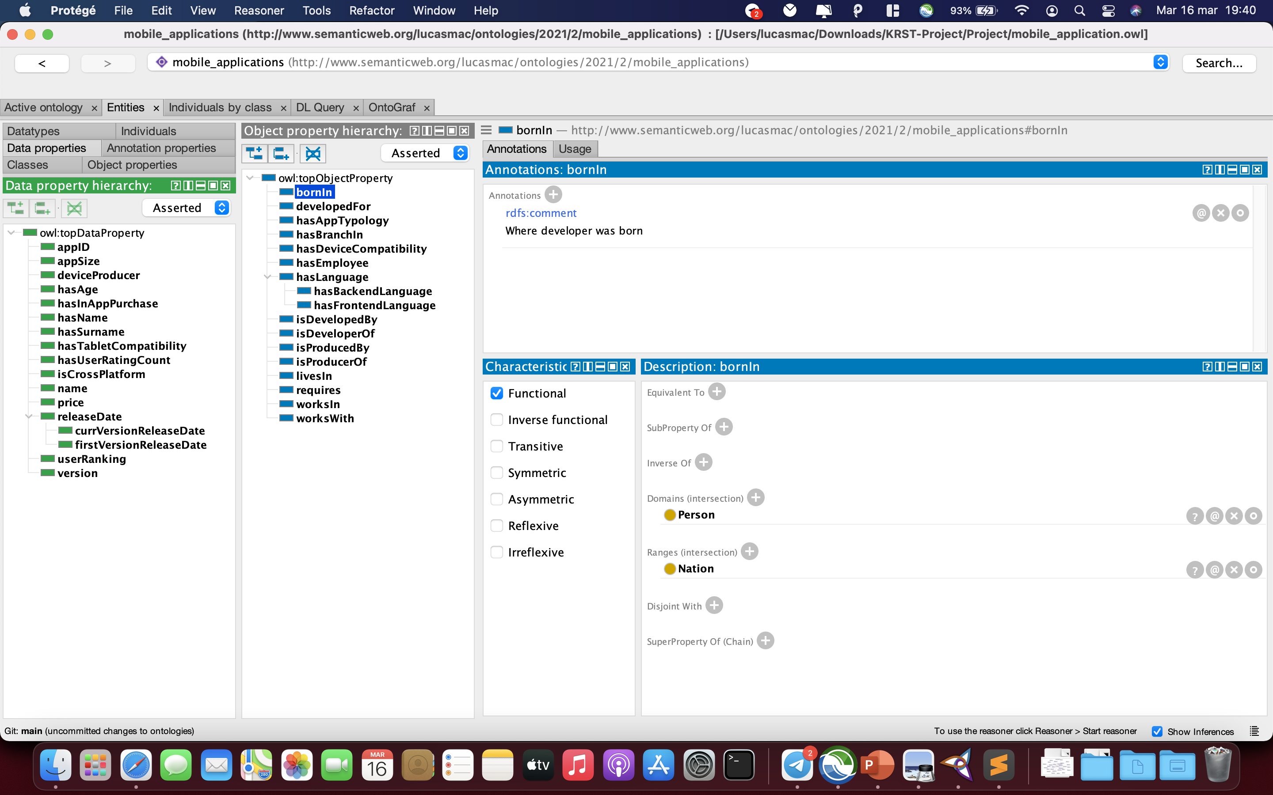
Object & Data Properties

Slide 13
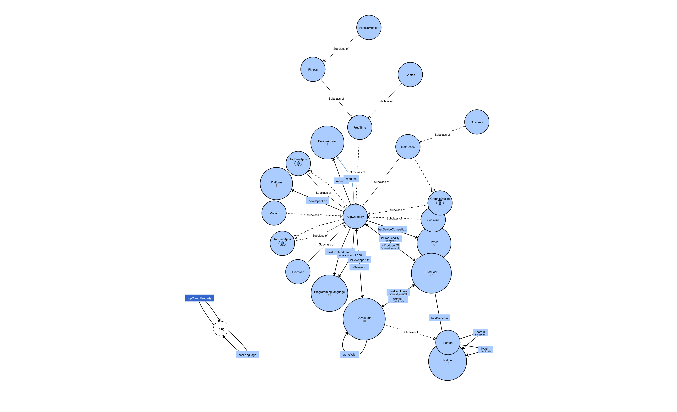
3
Representation
Entity-Relationship
Diagram

Slide 14
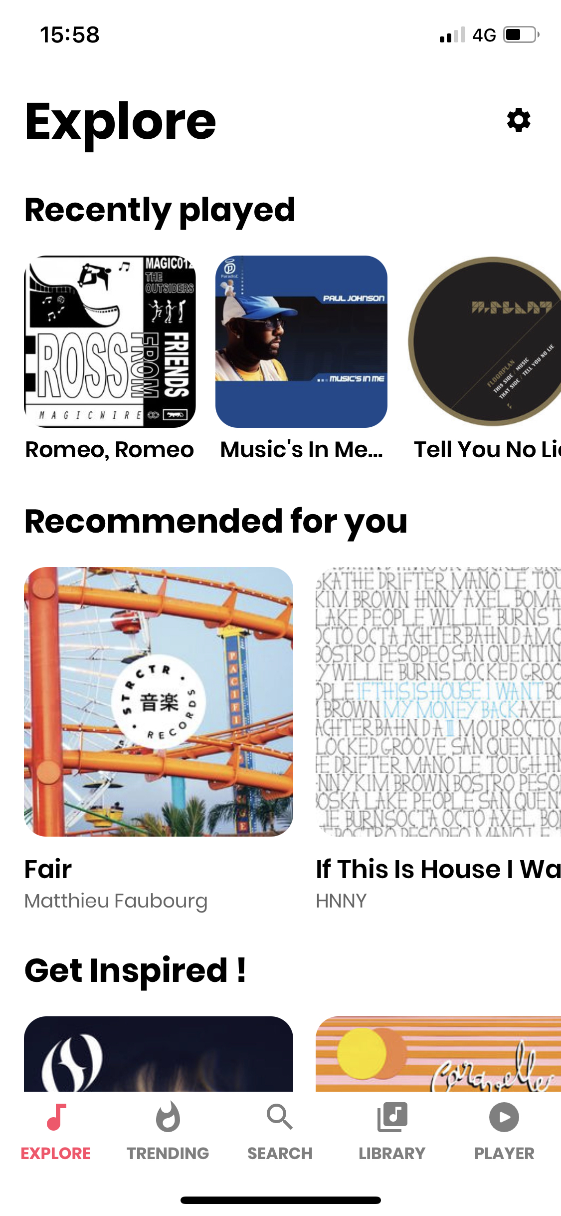

4
Quering Ontology
Once the ontology is complete, you can query the model created for a better understanding of the classification.
Have been made DL Queries and SPARQL Queries directly on Protégé.
Queries and their results are on my GitHub Repository

Slide 15

Thanks
And See You Next Time
GitHub Repository
Slides On Linkedin

